Slide 1
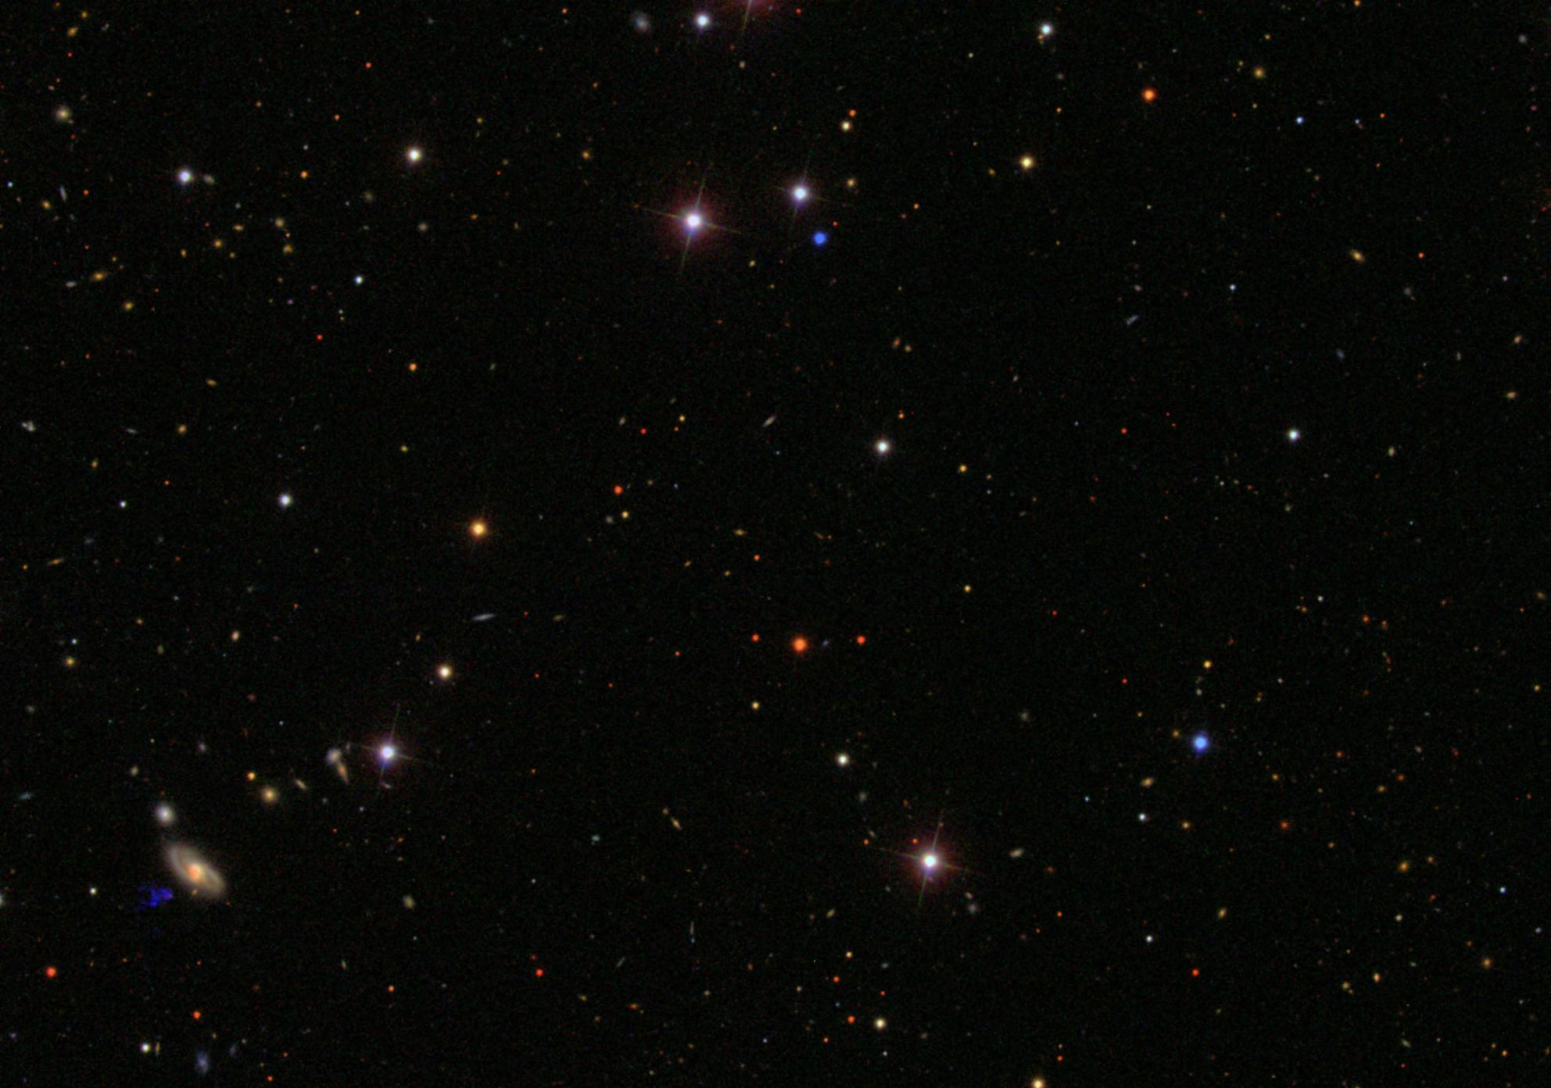
Statistical Analysis on SDSS Data
Astro-statistics Final Project
Rahul Ethirajulu
PhD Physics and Astronomy
Dept. of Physics and Astronomy
Texas Tech University

Slide 2
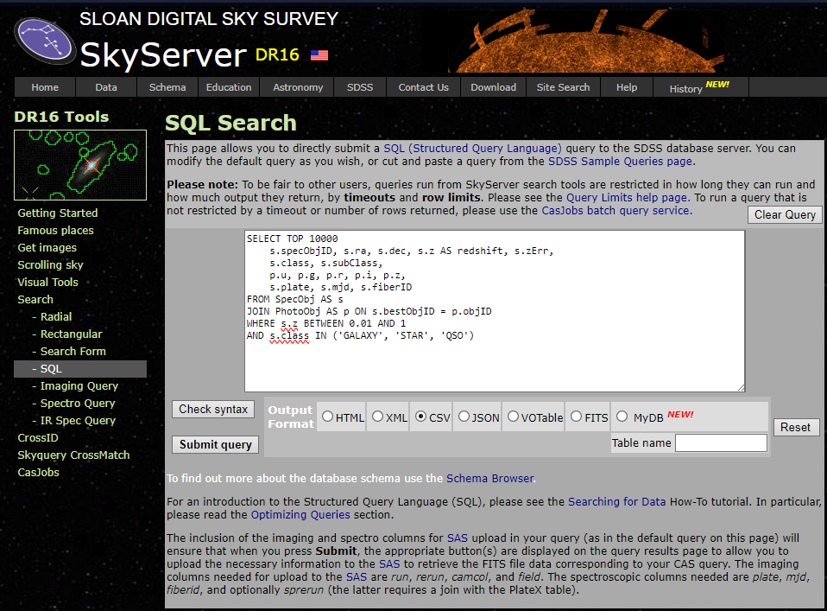
Where and How I got the data
Website – skyserver.sdss.org/dr16
SQL Query
Quasars, Stars, Galaxies
Requested Features
u, g, r, i, z
Redshift
ra, dec

Slide 3
Where and How I got the data
Website – skyserver.sdss.org/dr16
SQL Query
Quasars, Stars, Galaxies
Requested Features
u, g, r, i, z
Redshift
ra, dec
Din’t work

Slide 4
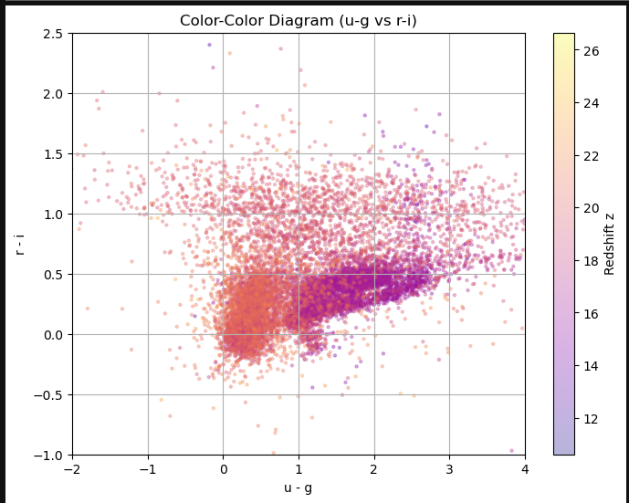
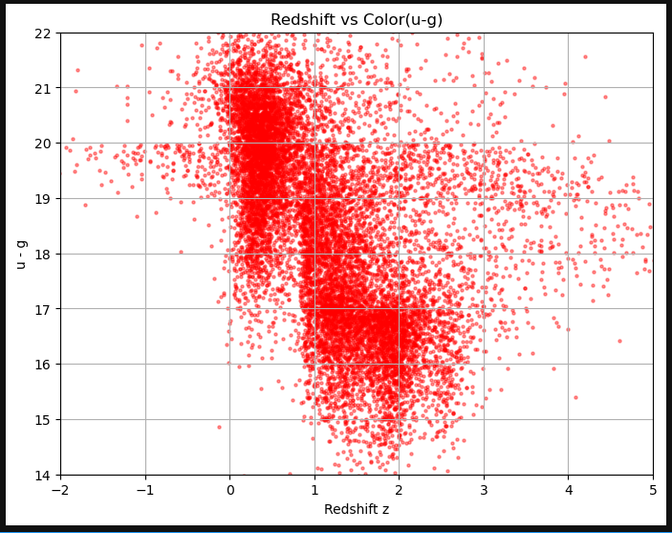
Data Visualization

Slide 5
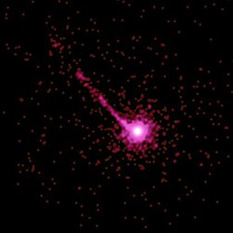
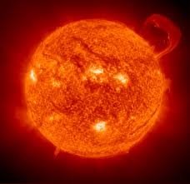
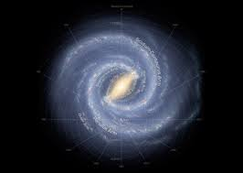
Classification – QSO vs Galaxy vs Star
PKS 1127-145

Slide 6
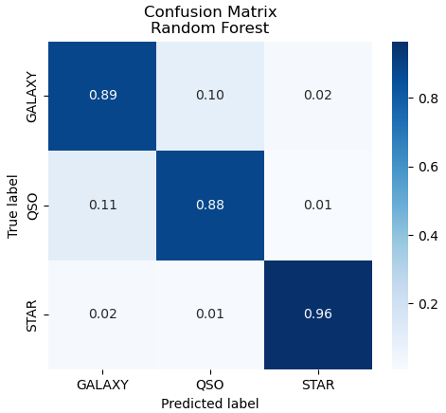

Test – Train split
Features
u-g, g-r, r-i, i-z
Output
Class
Classifiers Used
Random Forest
SVM
KNN
Logistic Regression
Gradient Boosting
Results – Not Bad!!
Notes:
Random Forest: an ensemble of many random decision trees that vote to make a robust final classification.
Support‑Vector Machine (SVM): finds the widest possible margin—or curved boundary via kernels—that separates the classes.
k‑Nearest Neighbours (KNN): labels a new point by the majority class among its k closest training examples.
Logistic Regression: fits a straight‑line equation and passes it through a sigmoid to turn the result into class probabilities.
Gradient Boosting: builds hundreds of tiny trees in sequence, each correcting the mistakes of the previous ones for a strong combined model.

Slide 7
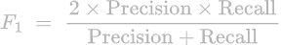
Metrics for Classification
Accuracy - (TP+TN)/total
Precision - TP/(TP+FP)
Recall - TP/(TP+FN).
F₁ combines Precision and Recall
$$= Harmonic mean of Recall and Precision$$

Slide 8
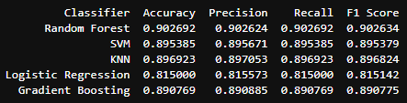
Best Classifier??

Slide 9
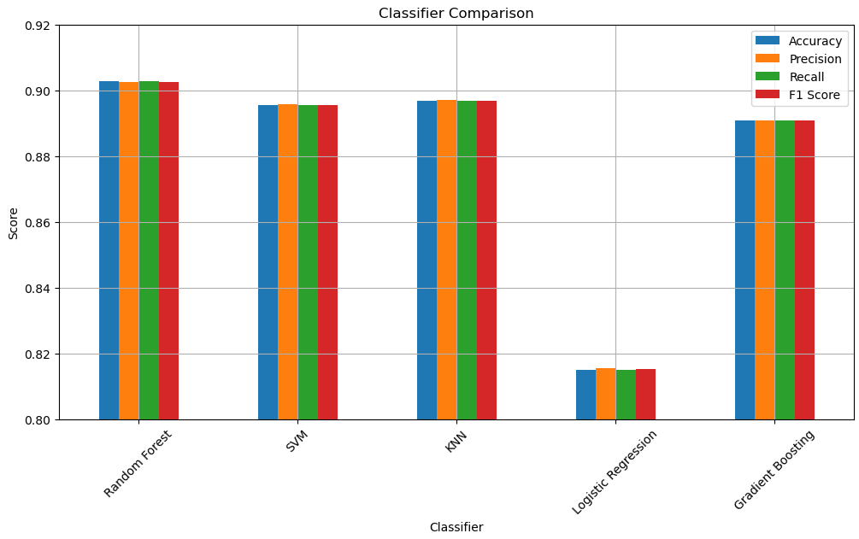
Best Classifier??

Slide 10

Regression – Predicting the redshift z

Slide 11
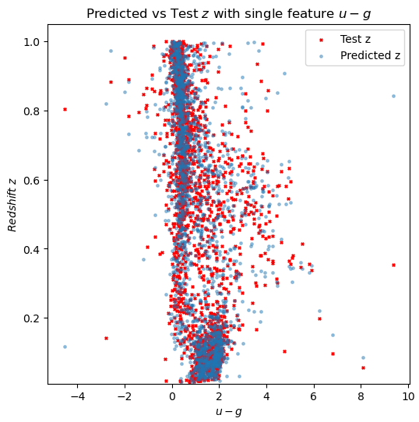
Test – Train split
Input Features
u-g, g-r, r-i, i-z
Prediction
Redshift
Regressors Used
Random Forest
Gradient Boosting
Linear Regression
Support Vector Regressor
K-Nearest Neighbors
Decision Tree
Random Forest

Slide 12
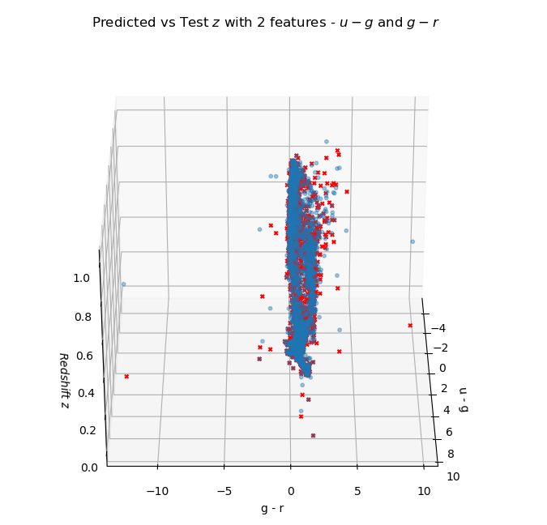
Test – Train split
Input Features
u-g, g-r, r-i, i-z
Prediction
Redshift
Regressors Used
Random Forest
Gradient Boosting
Linear Regression
Support Vector Regressor
K-Nearest Neighbors
Decision Tree
Random Forest

Slide 13
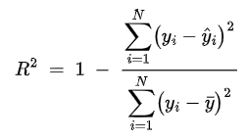
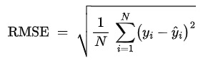
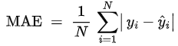
Metrics for Regressor
R² Score – how better is the model compared to just making mean guesses.
MAE
RMSE

Slide 14
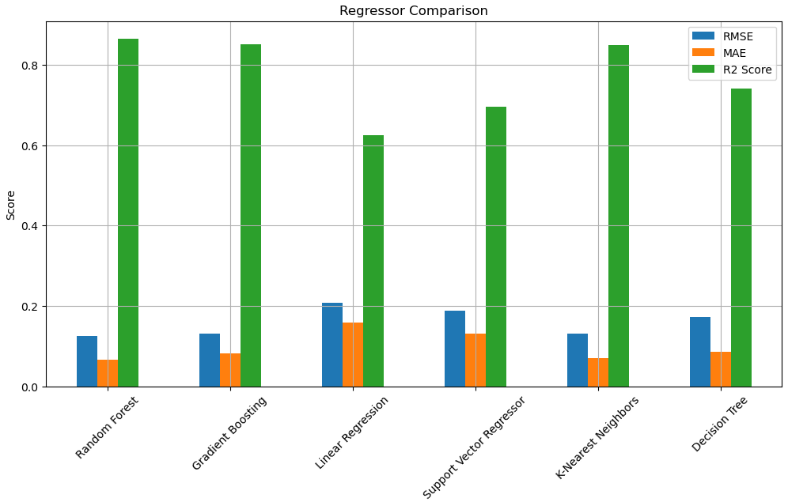
Best Regressor???
R2 – higher the better
RMSE – lower
MAE – lower

Slide 15
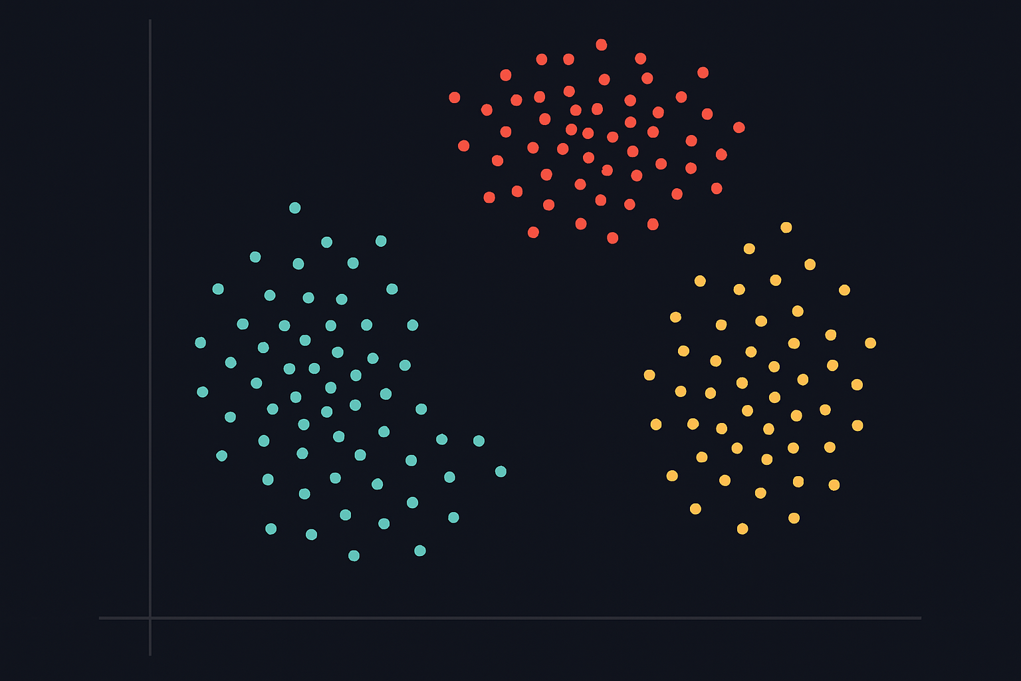
Star
Clustering
QSO
Galaxy

Slide 16
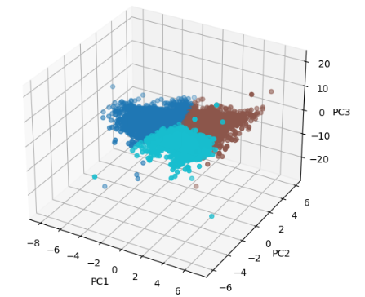
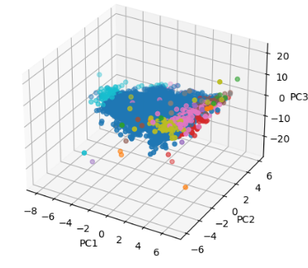
K-Means Clustering
Input Features
u-g, g-r, r-i, i-z
PCA – 3 features
Cluster models used
Kmeans
MeanShift
Agglomerative
DBSCAN
GMM
Mean Shift Clustering
Notes:
K‑Means: assigns points to the nearest of k centroids and iteratively relocates those centroids to the cluster means.
Mean‑Shift: slides each point uphill on a density surface until it reaches a peak, grouping all points that converge to the same mode.
Agglomerative (Hierarchical): starts with every point as its own cluster and repeatedly merges the closest pairs to build a cluster tree.
DBSCAN: grows clusters from points that have enough neighbours within a radius ε, labeling low‑density leftovers as noise.
Gaussian Mixture Model (GMM): fits the data as a weighted sum of Gaussian ellipsoids, giving each point a soft membership probability.

Slide 17
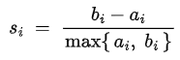
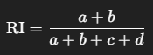
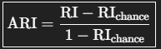
Metrics for Clustering
Adjusted Rand Score
Silhouette Score
Pair category | True Label | Predicted Label
a | same cluster | same cluster | true agreement
b | different clusters | different clusters | true disagreement
c | same | different | error type 1
d | different | same | error type 2
a_{i} - Average distance from i to all other points in its own cluster. b_{i} - Lowest average distance from i to points in any other cluster

Slide 18
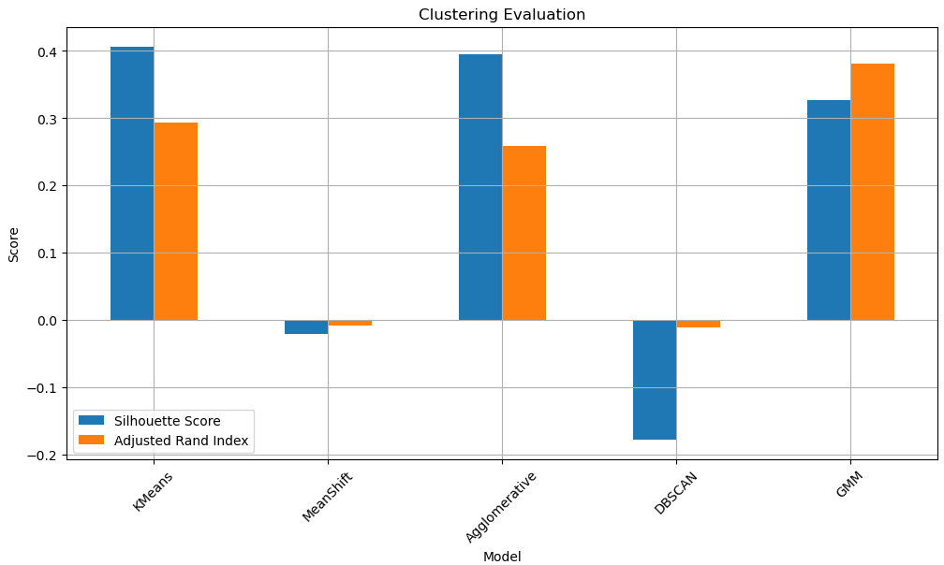
Best Clustering Model???

Slide 19
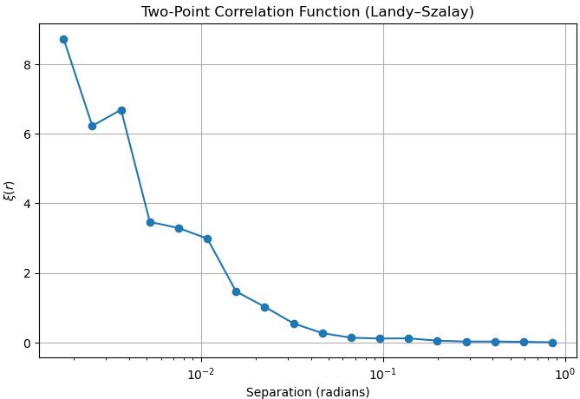
2 Point Correlation Function

Slide 20
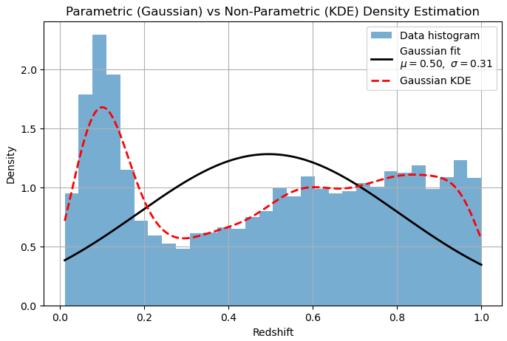
Parametric vs Non- Parametric Density Estimation

Slide 21
Conclusion
Classification, Regression and Clustering
Used different comparing metric for each analysis and found out the best fitting model.
Classification Random Forest
Regression Random Forest
Clustering K-Means

Slide 22
Conclusion
Future Work
Classification, Regression and Clustering
Used different comparing metric for each analysis and found out the best fitting model.
Classification Random Forest
Regression Random Forest
Clustering K-Means
2 Point correlation function
Density estimation – Parametric vs Non-Parametric
Get more data and compare different cosmological models with parameter estimation

Slide 23
Thank You Questions?

